Slide 1
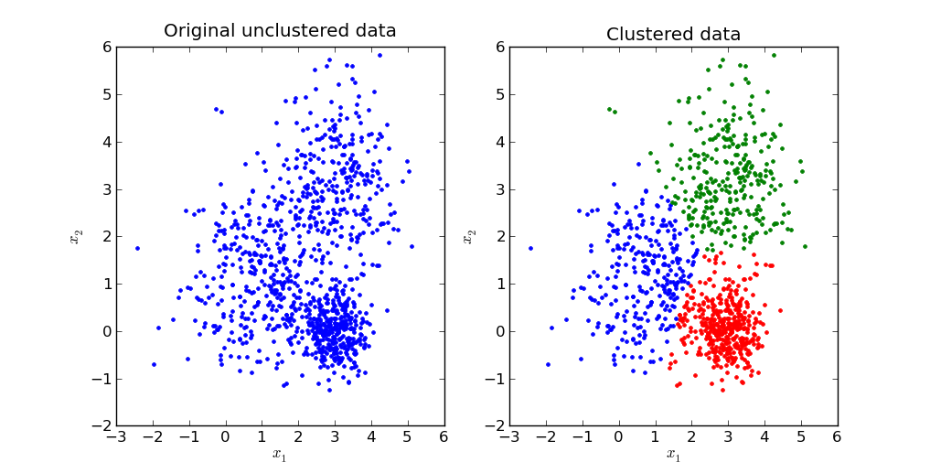
K-Mean Clustering Algorithm
k-means is one of the simplest unsupervised learning algorithms that solves the well-known clustering problem. The procedure follows a simple and easy way to classify a given data set through a certain number of clusters (assume k clusters)

Slide 2
K-Mean Clustering Algorithm
Problem
Divide the following data into two clusters using the k-mean clustering.
A(3,4) B(6,7) C(4,5), D(5,7) E(2,6)
Answer:
Initial Step: (Centroid selection)
For cluster-1: A(3, 4)
For cluster-2: C(4, 5)

Slide 3
K-Mean Clustering Algorithm
Iteration -1
Side note
Data | Cluster-1 Centroid(3,4) | Cluster-2 Centroid(4,5) | Cluster
A(3,4) | 0 | 1.414 | Cluster-1
B(6,7) | 4.242 | 2.828 | Cluster-2
C(4,5) | 1.414 | 0 | Cluster-2
D(5,7) | 3.605 | 2.236 | Cluster-2
E(2,6) | 2.236 | 2.236 | Cluster-1
Dist=(3−4)2+(4−5)2= 1.414
Dist=(6−3)2+(7−4)2= 4.242
Dist=(6−4)2+(7−5)2= 2.828
Dist=(5−3)2+(7−4)2= 3.605
Dist=(5−4)2+(7−5)2= 2.236
Dist=(2−3)2+(6−4)2= 2.236
Dist=(2−4)2+(6−5)2= 2.236

Slide 4
K-Mean Clustering Algorithm
Centroid Modification:
Cluster-1: A(3, 4) E(2, 6)
So, Centroid = ($$\frac{3+2}{2}, \frac{4+6}{2})$$= (2.5, 5)
Cluster-2: B(6, 7) C(4, 5) D(5, 7)
So, Centroid = ($$\frac{6+4+5}{3}, \frac{7+5+7}{3} )$$= (5, 6.33)

Slide 5
K-Mean Clustering Algorithm
Side note
Dist=(3−2.5)2+(4−5)2= 1.12
Dist=(3−5)2+(4−6.33)2=3.8
Dist=(6−2.5)2+(7−5)2= 4.03
Dist=(6−5)2+(7−6.33)2= 1.208
Dist=(4−2.5)2+(5−5)2= 1.5
Dist=(4−5)2+(5−6.33)2= 1.66
Iteration -2
Data | Cluster-1 Centroid(2.5,5) | Cluster-2 Centroid(5,6.33) | Cluster
A(3,4) | 1.12 | 3.8 | Cluster-1
B(6,7) | 4.03 | 1.208 | Cluster-2
C(4,5) | 1.5 | 1.66 | Cluster-1
D(5,7) | 3.2 | 0.67 | Cluster-2
E(2,6) | 1.12 | 3.01 | Cluster-1
Dist=(5−2.5)2+(7−5)2= 3.2
Dist=(5−5)2+(7−6.33)2= 0.67
Dist=(2−2.5)2+(6−5)2= 1.12
Dist=(2−5)2+(6−6.33)2= 3.01

Slide 6
K-Mean Clustering Algorithm
Centroid Modification:
Cluster-1: A(3, 4) C(4, 5) E(2, 6)
So, Centroid = ($$\frac{3+4+2}{3}, \frac{4+5+6}{3})$$= (3, 5)
Cluster-2: B(6, 7) D(5, 7)
So, Centroid = ($$\frac{6+7}{2}, \frac{7+5}{2})$$= (5.5, 7)

Slide 7
K-Mean Clustering Algorithm
Side note
Dist=(3−3)2+(4−5)2= 1
Dist=(3−5.5)2+(4−7)2=3.91
Dist=(6−3)2+(7−5)2= 3.67
Dist=(6−5.5)2+(7−7)2= 0.5
Dist=(4−3)2+(5−5)2= 1
Dist=(4−5.5)2+(5−7)2= 2.5
Iteration -3
Data | Cluster-1 Centroid(3,5) | Cluster-2 Centroid(5.5, 7) | Cluster
A(3,4) | 1 | 3.91 | Cluster-1
B(6,7) | 3.67 | 0.5 | Cluster-2
C(4,5) | 1 | 2.5 | Cluster-1
D(5,7) | 2.83 | 0.25 | Cluster-2
E(2,6) | 1.12 | 3.64 | Cluster-1
Dist=(5−3)2+(7−5)2= 2.83
Dist=(5−5.5)2+(7−7)2= 0.25
Dist=(2−3)2+(6−5)2= 1.12
Dist=(2−5.5)2+(6−7)2= 3.64

Slide 8
K-Mean Clustering Algorithm
Centroid Modification:
Cluster-1: A(3, 4) C(4, 5) E(2, 6)
So, Centroid = ($$\frac{3+4+2}{3}, \frac{4+5+6}{3})$$= (3, 5)
Cluster-2: B(6, 7) D(5, 7)
So, Centroid = ($$\frac{6+7}{2}, \frac{7+5}{2})$$= (5.5, 7)
Final Output
Data | Cluster | Centroid
A(3,4) C(4,5) E(2,6) | Cluster-1 | (3,5)
B(6,7) D(5,7) | Cluster-2 | (5.5, 7)

